Slide 1
Lab 3 (Distributed System)
Rajib Chandra Das Sarker Miraz Mahfuz

Slide 2
What we have Implemented!
Design Decentralized system
Implement using Vector Clock
Data eventually Consistent
Implement operation history management
Eventually Consistent in presence of Network Segmentation

Slide 3
Task 1

Slide 4
Steps for normal event
Event from a client (add / modify /delete)
Generate a Unique id (only for add)
Update local clock
Update own blackboard content
Add the whole operation to history
Propagate to all server

Slide 5
Steps for propagation event
Check own history
Rollback on operations to maintain causal relation
Update own blackboard for propagated event
Update vector clock
Add the whole operation to history
Commit all the rollback operations

Slide 6
Why Vector clock
Vector clock is unique for every operation
We can detect concurrent events
Obey causality
But uses more space per request

Slide 7
Our ordering procedure
Va == Vb iff Va[i] ==Vb[i] for all i in N
Va <= Vb iff Va[i] <=Vb[i] for all i in N
Va < Vb iff Va <= Vb && there exist a j for which Va[j] < Vb[j]
A ➔ B
For concurrent events we ordered using logical (lamport) timestamp within the vector clocks and index of the server

Slide 8
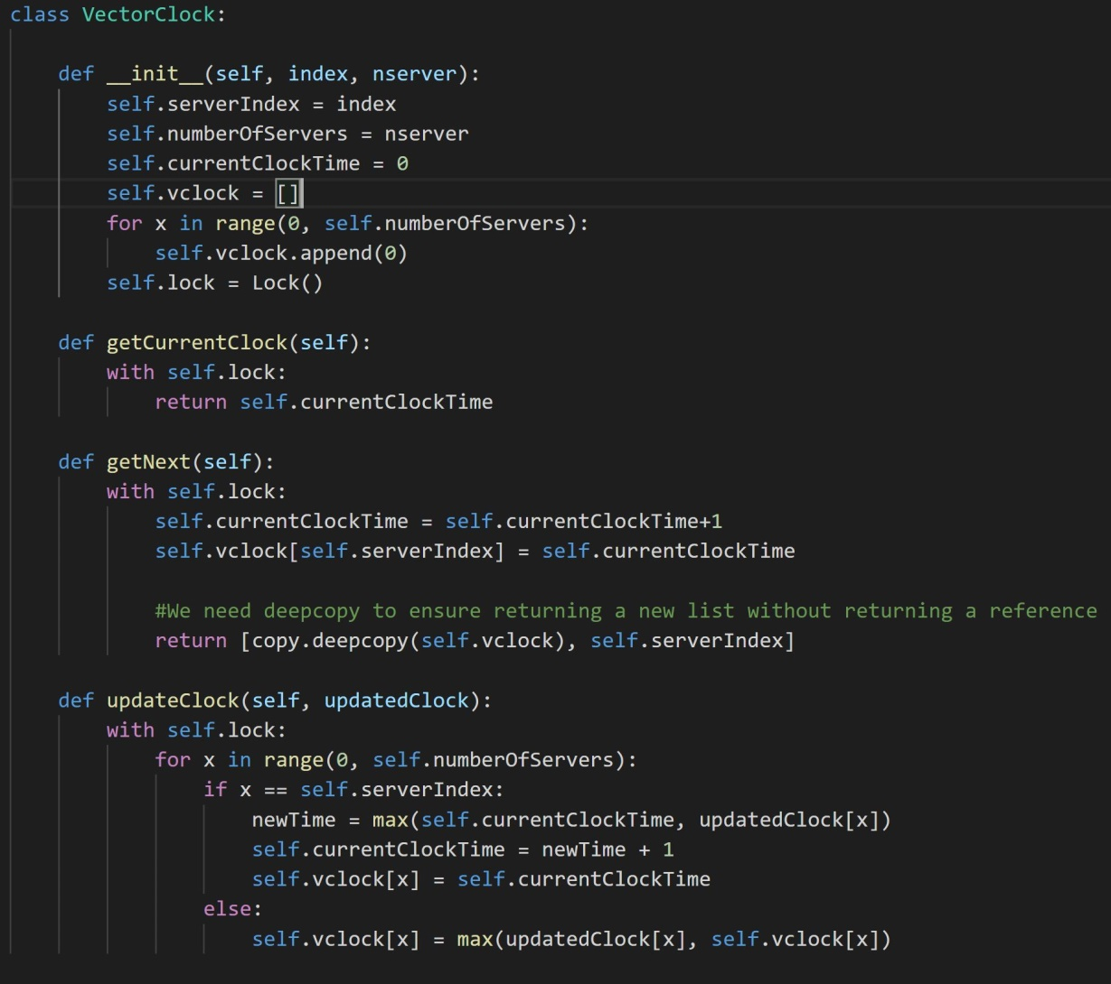

Slide 9
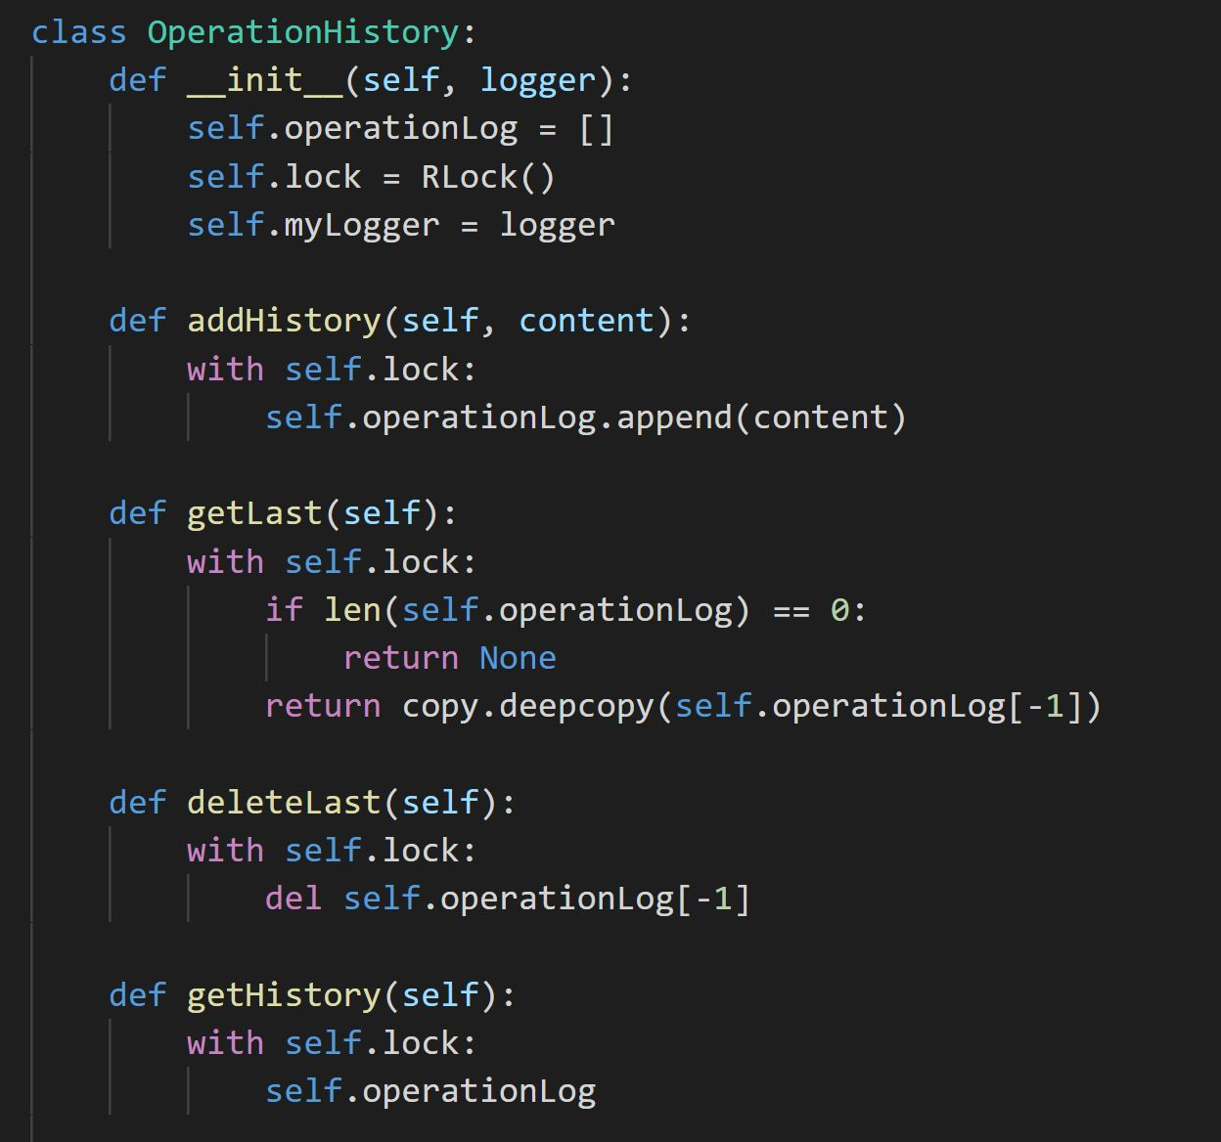

Slide 10
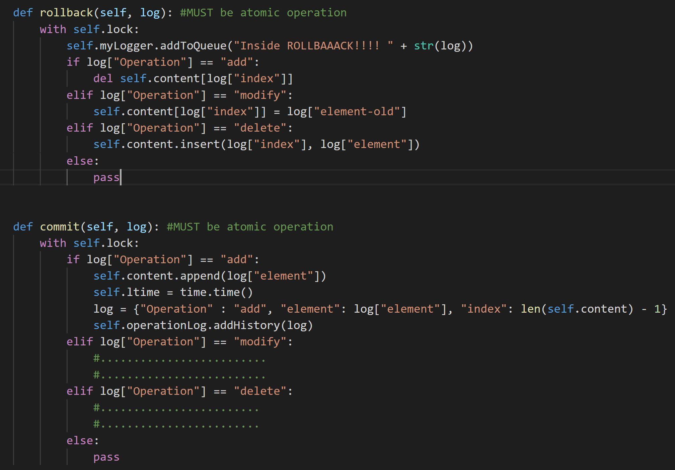

Slide 11
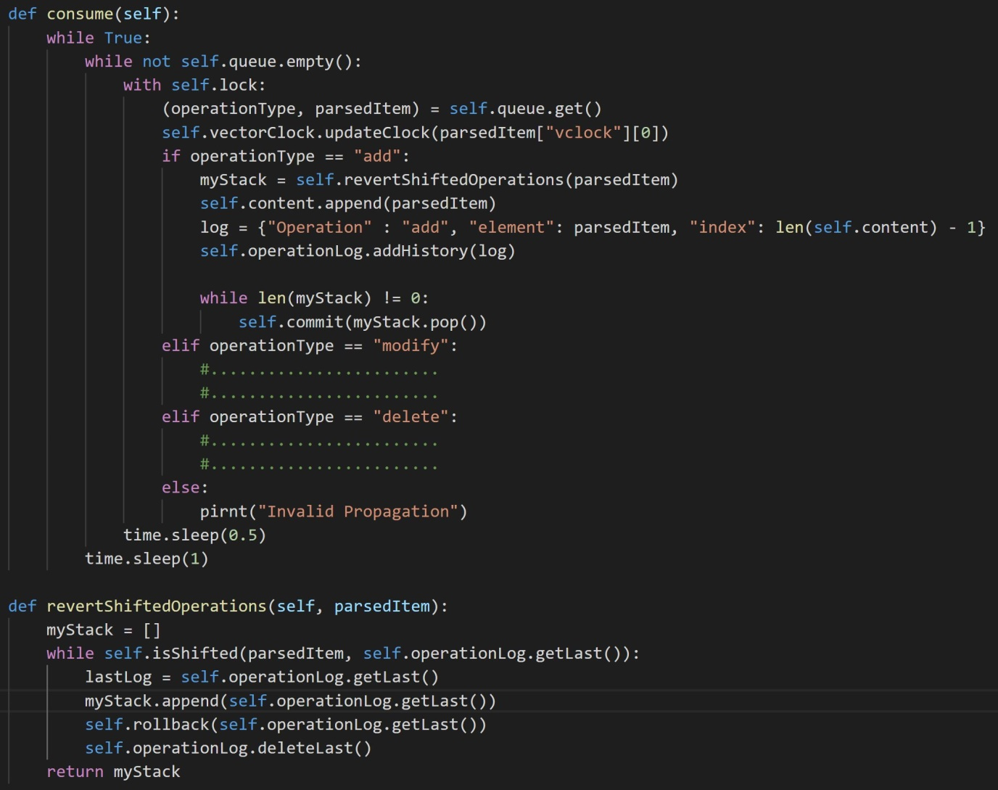

Slide 12
Task 2

Slide 13
For 10 concurrent messages to each server
Time in (sec)
Number of servers

Slide 14
Task 3

Slide 15
Steps to maintain eventual consistency on network segmentation
Query every server for history size
Check difference of local history within 10 sec interval
If 3 consecutive request yields same remote history size which is greater than local history size then request for latest data
After getting the data we update local history, blackboard and vector clock

Slide 16
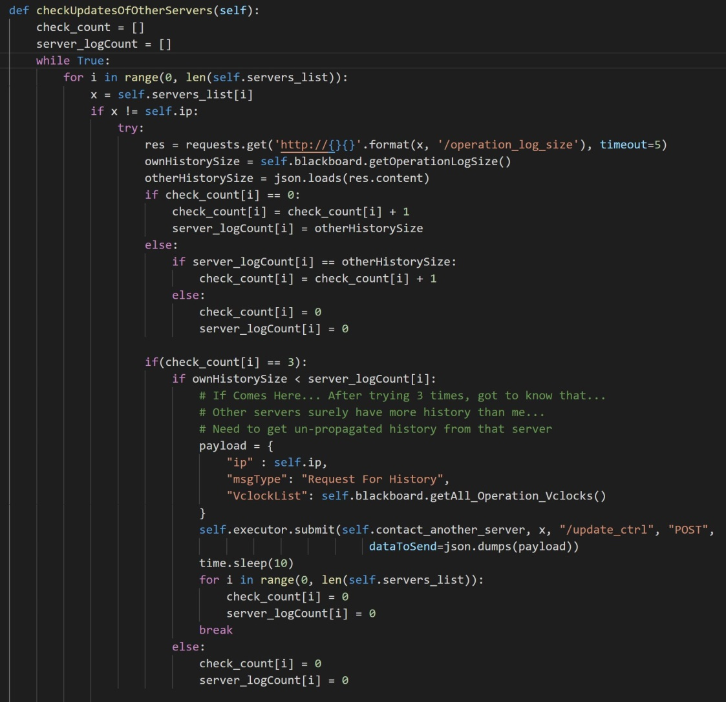

Slide 17
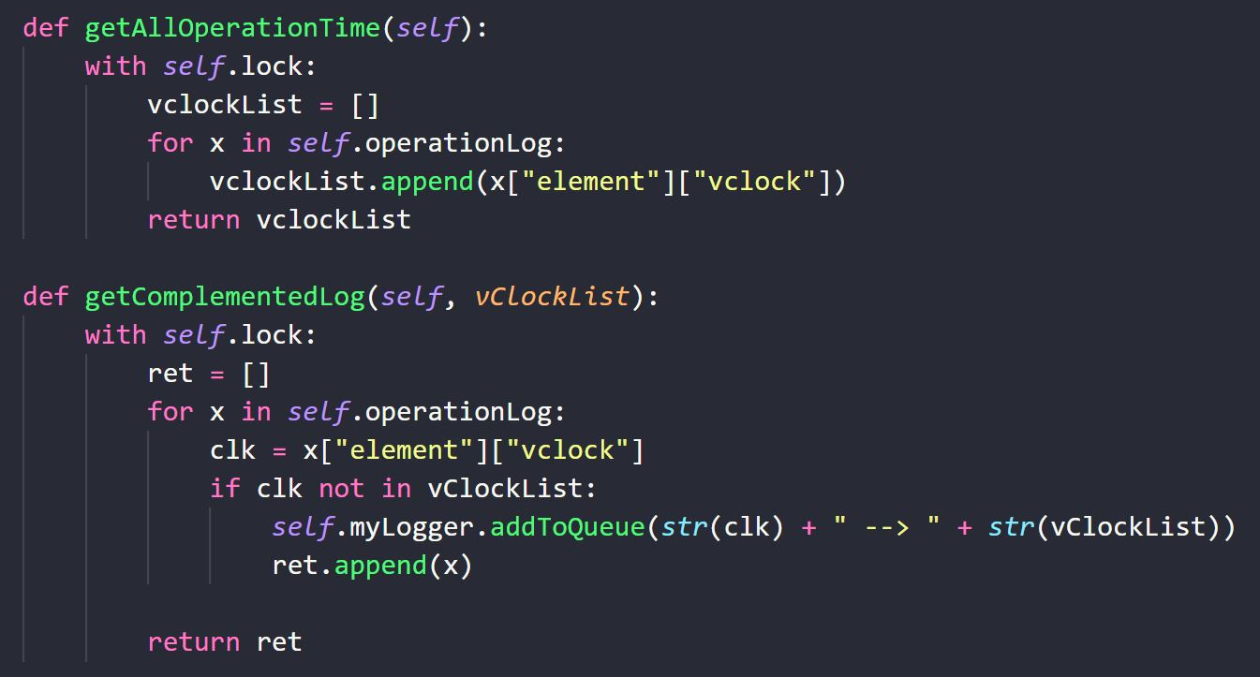

Slide 18
Any Questions ?

